Slide 1
CONFERENCE PRESENTATION
Project title: Optimizing Telecom Operations with Segmentation and Churn Prediction . (IDCIoT-1472 )
Presented by –
D.Neha - 21951A05B8
Mohammed Ameesha - 21951A05A4 M.Dheeraj – 21951A0538
Ms. K. Sangeeta - Mentor

Slide 2
ABSTRACT
Client turnover is a major challenge for large companies, especially in the telecom sector, as it directly affects profitability. Telecom providers are increasingly focused on developing methods to predict customer churn to mitigate its negative effects. Understanding the factors that contribute to churn is essential for preventing it. This work's primary contribution is the development of a churn prediction model, which helps telecom providers identify customers at high risk of churning. We explore different data analysis scenarios and display the results using graphical representations. Our model, built using machine learning techniques, leverages large datasets and introduces a novel approach for feature design and selection. The datasets used for training, evaluation, and validation include historical customer data from previous months. We experimented with four machine learning algorithms: Logistic Regression, XGBoost, gradient-boosted machine (GBM) Trees, Random Forests, and Decision Trees. To enhance accuracy, we applied parameter tuning during training. The goal of this study is to optimize telecom operations through effective segmentation and churn prediction, ultimately improving operational efficiency and customer retention.

Slide 3
PROBLEM STATEMENT
The telecommunication industry faces significant challenges due to customer churn, where subscribers discontinue their services, leading to revenue loss and increased customer acquisition costs. This project aims to develop a machine learning model to predict customer churn by analyzing user behavior, service usage patterns, and demographic data. Accurate churn prediction enables telecom companies to proactively engage at-risk customers with retention strategies, such as personalized offers or service improvements. The goal is to enhance customer satisfaction, reduce churn rates, and ultimately increase profitability. The solution involves using various algorithms to process historical data and identify key indicators of churn.

Slide 4
OBJECTIVE
Develop a machine learning model that predicts customer churn with high accuracy. Utilize data from customer historical interactions, usage patterns, and demographic information to inform predictions.
Proactive Identification:
- Enable early detection of customers at risk of churning.
- Empower telecom companies to take proactive retention measures to address potential issues.
Personalized Interventions:
- Enhance the ability to design and deliver tailored retention strategies that resonate with individual customer needs and preferences.
- Focus on improving customer satisfaction and long-term loyalty through personalized communication and offers.
Resource Optimization:
- Allocate resources effectively by focusing on high-risk customer segments, optimizing the use of marketing and customer support efforts.
- Ensure cost-efficient retention strategies that maximize return on investment.
Business Impact:
- Achieve a significant reduction in customer attrition rates, directly lowering revenue loss.
- Enhance the overall customer experience, boosting the company’s reputation and competitive advantage.

Slide 5
EXISTING SYSTEM
Rule-Based Systems:
Description: These systems use predefined rules and thresholds based on domain expertise to flag customers as potential churn risks. For example, a rule might be set to label a customer as likely to churn if they haven’t used the service for a certain number of days.
Disadvantages:
  Static and Inflexible: Rules are fixed and may not adapt well to changing customer behaviors or market conditions.
Statistical Methods:
Description: Techniques such as logistic regression and survival analysis are commonly used to model the probability of churn based on historical data. These methods rely on statistical theories to establish relationships between churn and various customer attributes.
Disadvantages:
  Assumptions and Simplifications: Many statistical models assume linear relationships and may oversimplify the data.

Slide 6
PROPOSED SYSTEM
The proposed system leverages machine learning algorithms to predict customer churn by analyzing comprehensive customer data, including usage patterns, service interactions, and demographic factors. It employs advanced techniques such as ensemble learning and deep learning to enhance predictive accuracy and adaptability to changing customer behaviors. By integrating continuous learning capabilities, the system dynamically updates its predictions and models to stay current with evolving data trends. This proactive approach allows telecom companies to implement personalized retention strategies, improving customer satisfaction and reducing churn rates. The system aims to be scalable and robust, capable of handling large datasets typical in the telecom industry.

Slide 7
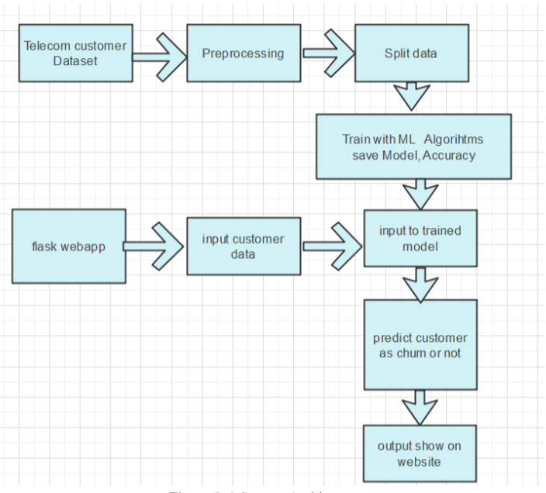
SYSTEM DESIGN AND WORKFLOW
DATA COLLECTION:
In this project we use telecom customer dataset collected from Kaggle which has few features related to connections and taken services features which are collected from churn prediction and 0 and 1 as labels.
PRE-PROCESSING:
our dataset consists of 21 features and even the evaluation of those lowest effective dose in the dataset. This method searches key features and selects all 21 features for training the machine using Machine learning models.Then split the data into test and train.Train the machine with 80% training data .This training data contains feature and label.Remain 20% split-up was used to test the machine

Slide 8
SYSTEM DESIGN
TRAIN-TEST SPLIT AND MODEL FITTING:
Now, we divide our dataset into training and testing data. Our objective for doing this split is to assess the performance of our model on unseen data and to determine how well our model has generalized on training data. This is followed by a model fitting which is an essential step in the model building process.
Model Evaluation and Predictions:
This is the final step, in which we assess how well our model has performed on testing data using certain scoring metrics, I have used 'accuracy score' to evaluate my model. First, we create a model instance, this is followed by fitting the training data on the model using a fit method and then we will use the predict method to make predictions on x_test or the testing data, these predictions will be stored in a variable called y_test_sap. For model evaluation, we will feed the y_test and y_test_sap into the accuracy_score function and store it in a variable called test_accuracy, a variable that will hold the testing accuracy of our model. We followed these steps for a variety of classification algorithm models and obtained corresponding test accuracy scores.

Slide 9
ALGORITHMS
Logistic regression
What it does: Logistic regression is a statistical method used for binary classification. It predicts the probability of a binary outcome (e.g., churn vs. non-churn) based on one or more predictor variables (e.g., customer demographics, usage patterns, and service data). The model uses a logistic function (sigmoid) to output probabilities between 0 and 1.
Why we are using it:
Simplicity & Interpretability: Logistic regression is easy to implement and understand. It's effective for problems where the relationship between the features and the target variable is approximately linear.
Baseline Model: It serves as a good baseline model. If logistic regression performs well, more complex models may not be necessary.
Probability Outputs: Logistic regression provides probability scores, which are valuable in customer churn prediction to estimate the likelihood of churn and take proactive actions.

Slide 10
ALGORITHMS
XGBoost (Extreme Gradient Boosting)
What it does: XGBoost is an advanced machine learning algorithm that belongs to the family of gradient boosting methods. It builds an ensemble of decision trees in a sequential manner, where each tree corrects the errors of the previous tree. XGBoost uses gradient descent to minimize errors, making it highly efficient.
Why we are using it:
Accuracy: XGBoost often provides top-tier performance in many machine learning tasks, especially with large and complex datasets.
Handling Overfitting: Through regularization, XGBoost reduces the risk of overfitting, making it ideal for noisy telecom data
Handling Missing Data: It can handle missing values internally, which is useful if there is missing information in customer records.

Slide 11
ALGORITHMS
Gradient-Boosted Machine (GBM) Trees
What it does: GBM builds an ensemble of weak learners (usually decision trees), where each tree learns to correct the errors made by the previous one. The "gradient" refers to the algorithm’s optimization process, where the gradient of the loss function is used to minimize prediction errors.
Why we are using it:
High Accuracy: GBMs are known for their accuracy, especially when dealing with large, high-dimensional data like telecom customer records.
Flexibility: They can be used for both regression and classification tasks. In churn prediction, they help determine the likelihood of a customer leaving.
Improved Performance: GBMs reduce errors effectively by focusing on hard-to-predict examples, improving the overall performance of the model.

Slide 12
ALGORITHMS
Random Forests
What it does: Random forests are an ensemble method that combines multiple decision trees. Each tree in the forest is trained on a random subset of the data, and the final prediction is made by averaging the results (for regression) or voting (for classification).
Why we are using it:
Reduced Overfitting: By averaging multiple trees, random forests reduce overfitting, making the model more generalizable to unseen data.
Robustness: Random forests are less sensitive to noisy data and can handle large datasets effectively.
Feature Importance: Like XGBoost, random forests also provide insights into the importance of features, which can help telecom companies identify factors influencing churn.
Versatility: They work well for both categorical and numerical data, which is essential when dealing with diverse customer information.

Slide 13
ALGORITHMS
Decision Trees
What it does: Decision trees are a flowchart-like structure where each internal node represents a decision based on a feature, and each leaf node represents a predicted outcome. The tree is built by splitting the data at each node in such a way that it maximizes the "purity" of the outcomes at the leaves (e.g., most customers who are likely to churn are grouped together).
Why we are using it:
Interpretability: Decision trees are easy to interpret and visualize. This makes them useful for understanding how specific features (e.g., customer tenure, usage patterns) affect churn.
Efficiency: They are computationally inexpensive and can be trained relatively quickly compared to more complex models like XGBoost.
Base Model for Other Ensemble Methods: Decision trees serve as the base learner in more advanced ensemble methods like random forests and gradient boosting.

Slide 14
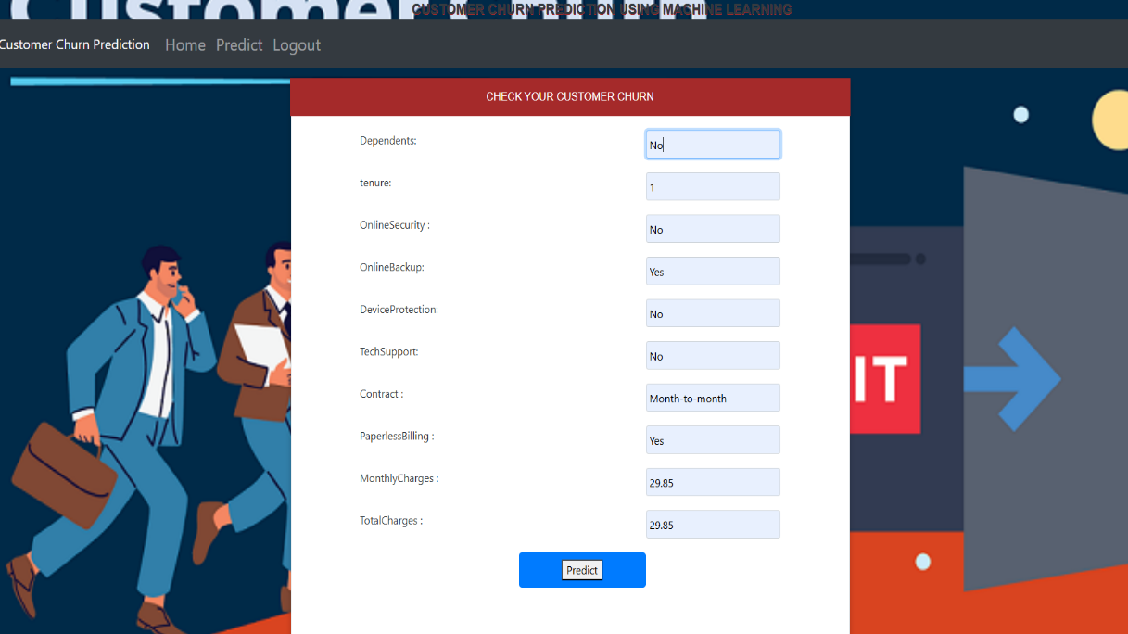
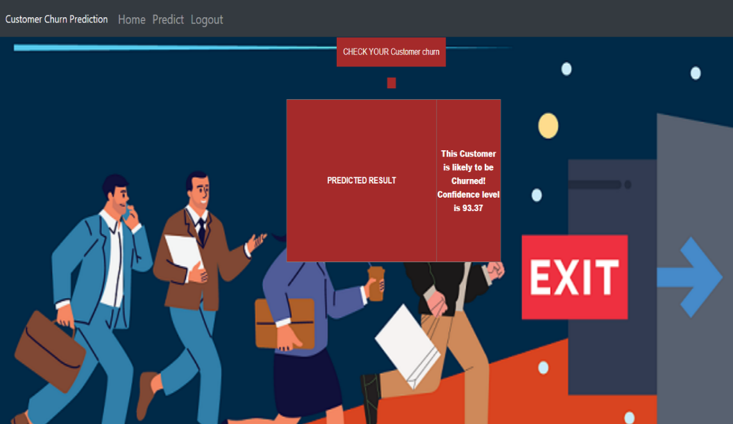
RESULT
A customer churn checking page for a customer churn prediction system serves as the interface where users can input customer data to assess the likelihood of churn. This page typically includes input fields to enter customer attributes such as demographic details, transaction history, and usage patterns.
Fig . Prediction page Fig. Result page
This page typically displays the prediction results, including whether a customer is likely to churn or not, along with key metrics and factors influencing the prediction.

Slide 15
RESULT
Key Components of the Churn Prediction Result Page:
1. Prediction Outcome: Clearly displays the prediction result, such as "Likely to Churn" or "Not Likely to Churn," giving a quick overview of the customer’s status.
2. Probability Score: Shows the probability or confidence level of the prediction, such as “Churn Probability: 93.37%,” helping users understand the certainty of the result
COMPARISION OF MACHINE LEARNING MODELS FOR CUSTOMER CHURN PREDICTION
Model | Accuracy Score
Decision Tree Classifier | 0.94
Random Forest Classifier | 0.95
Logistic Regression | 0.93
Gradient Boosting Classifier | 0.96

Slide 16
CONCLUSION
The purpose of this kind of study in the telecom industry is to aid businesses in increasing their profits. It is well known that one of the most significant revenue streams for telecom firms is churn prediction. The purpose of this study was to create a system that anticipates client attrition to be successful, prediction models must have high AUC values. The sampling data is split into 80% for training and 20% for validation in order to test or train the model. We picked to carry out for hyper - parameters adjustment and validation. To prepare the characteristics for machine learning algorithms, we used feature engineering, effective feature transformations, and selection methods. We also ran across the issue that the data was not balanced. Only 5% of the entries are customer turnover. This issue was resolved by under sampling or by utilising methods for trees that were not impacted by the issue. Due to their variety and suitability for this kind of predictions, four tree-based techniques were chosen. It includes the algorithms Decision Tree, Random Forest, and GBM tree.

Slide 17

Presented by –
D.Neha - 21951A05B8
Mohammed Ameesha - 21951A05A4 M.Dheeraj – 21951A0538
Ms. K. Sangeeta - Mentor

